Slide 1
Exploratory Data Analysis(EDA) for Real Estate Pricing
Presented by:- SURABHI PATIL

Slide 2
Tools and Libraries used:
Tools:
Jupyter Notebook (Interactive coding environment)
Python(Programming language)
Libraries:
Pandas(Data manipulation and analysis)
NumPy(Numerical computations)
SciPy(Statistical analysis)
Matplotlib(Data visualization)
Seaborn(Advanced data visualization)
Plotly(Interactive visualizations)
Scikit-learn(Machine learning)

Slide 3
Problem Statement:
Identify key variables influencing house prices-
Optimal pricing
Market trends
Investment decisions

Slide 4
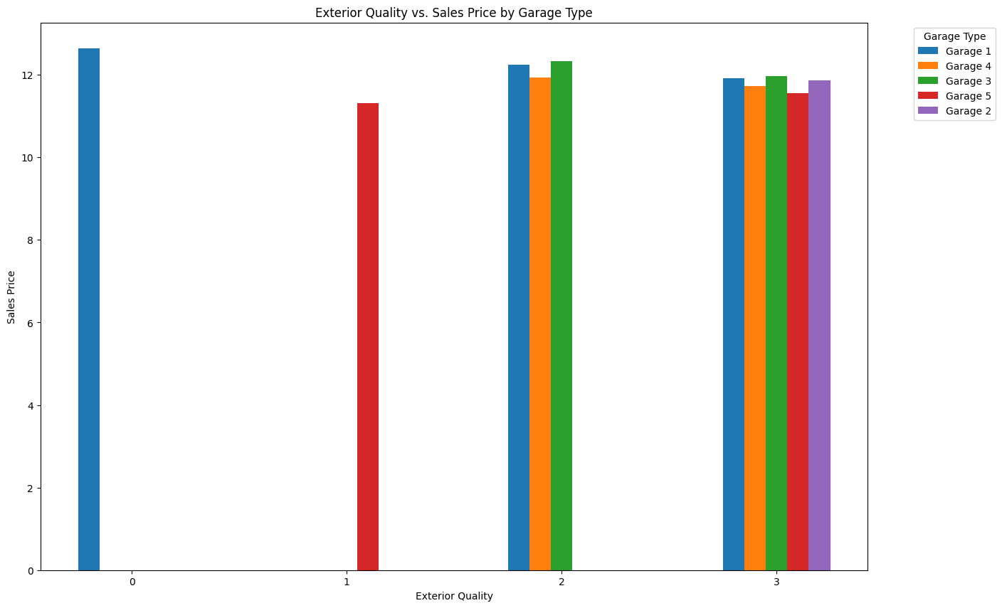

Slide 5
Exterior Quality vs. Sales Price by Garage Type:
This graph analyzes sales price variations across Exterior Quality levels for five garage types.
Garage 1 dominance: Highest sales price ($12,000+) at Exterior Quality 0 and 1
Convergence at Quality 3: Garage Types 1, 3, and 4 reach similar prices (> $12,000)
Garage 5 emergence: Notable sales price ($10,000+) at Exterior Quality 2
Garage 4 potential: Consistent sales price growth across quality levels

Slide 6
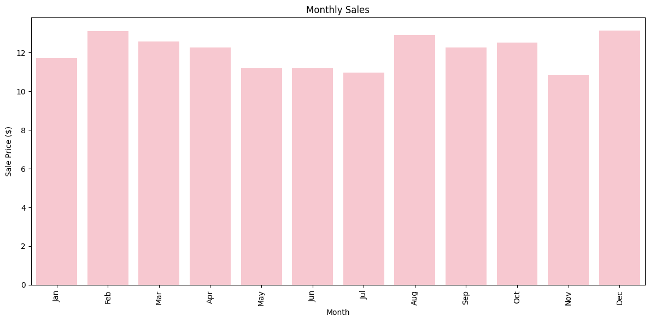
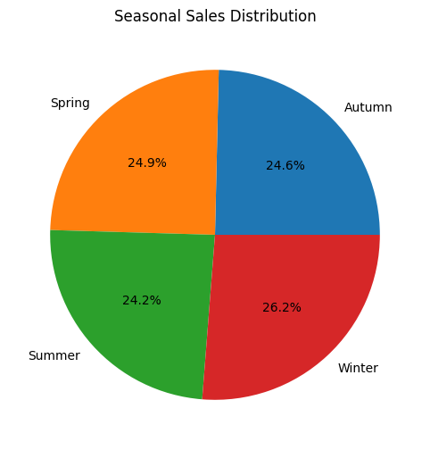

Slide 7
Monthly Sales Price:
Peak Sales Periods: February and December experience the highest monthly sales
Seasonal Demand: Sales surge during holiday seasons (December) and pre-spring (February)
Dominant Season: Winter accounts for 26.2% of total sales
Balanced Seasons: Spring (24.9%), Autumn (24.6%), and Summer (24.2%) share relatively equal sales
Minimal Variation: Less than 2% difference between seasonal sales percentages
Key Insights: Winter's higher sales may be attributed to holiday seasons or colder climate demand

Slide 8
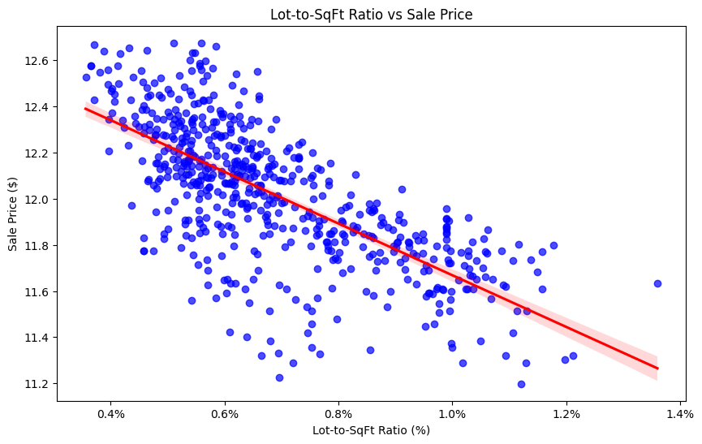

Slide 9
Lot-to-Square Foot Ratio vs. Sales Price Analysis
Inverse Relationship: As Lot-to-Square Foot Ratio increases, Sales Price generally decreases
High-Price Outliers: Scattered data points at lower ratios (0.4-0.6) indicate higher sales prices
Price Decrease: Sales prices decline steadily beyond 0.8 ratio
Optimal Ratio: Ratios between 0.8-1.2 correspond to relatively stable, lower sales prices
Saturation Point: Beyond 1.4 ratio, sales prices level off

Slide 10
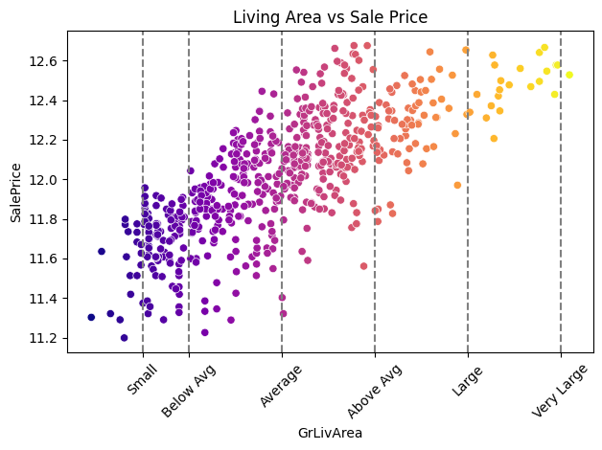

Slide 11
Living Area Sales Price:
Positive Correlation: Sales price increases with living area size
Proportional Relationship: Larger living areas command higher prices
Price Increment: Every incremental increase in living area corresponds to a price increase
Size Matters: Living area significantly impacts sales price
Luxury Segment: Larger living areas (> Average) drive premium prices
Affordability: Smaller living areas (< Average) offer affordable options.

Slide 12
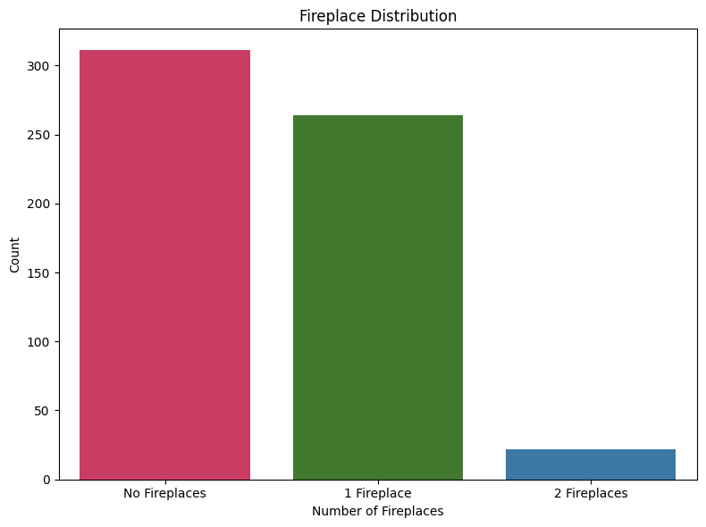

Slide 13
Data Insights:
No Fireplaces: 311 homes (44.8% of total)
1 Fireplace: 264 homes (38.0% of total)
2 Fireplaces: 22 homes (3.2% of total)

Slide 14
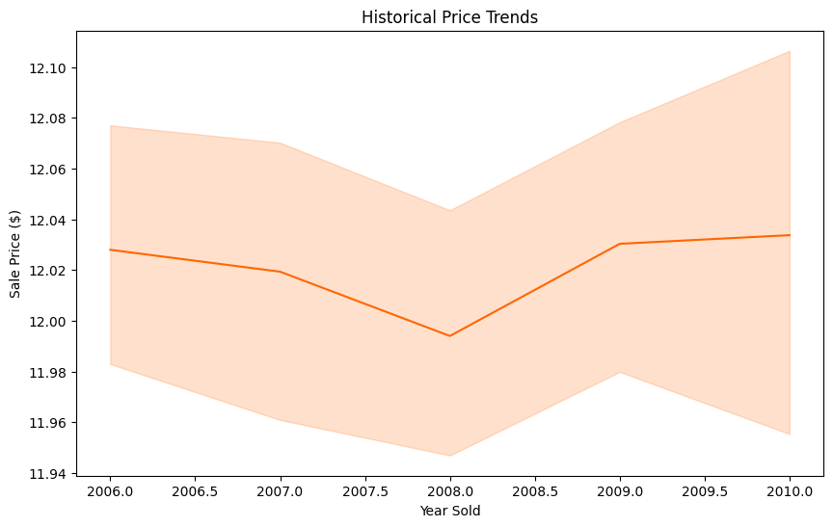
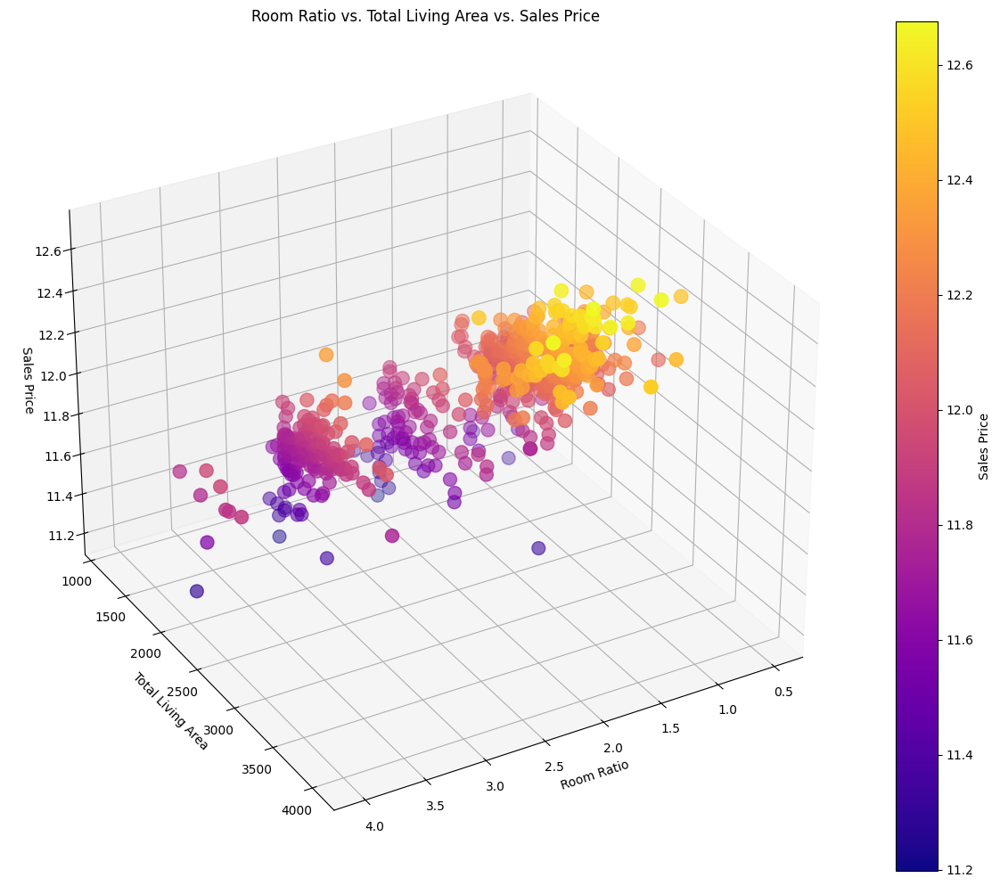

Slide 15
Conclusions:
Data Preparation: Ensured data integrity through missing value handling, outlier removal, and data normalization
Analytical Insights: Univariate, multivariate, and feature engineering techniques revealed key drivers: living area, lot-to-square-foot ratio, and seasonal demand
Key Takeaways:- Seasonal fluctuations impact sales.- Living area size influences pricing.- Efficient land utilization optimizes property value
Practical Applications: Stakeholders can optimize pricing, investment, and development strategies.

Slide 16
THANK YOU

